Slide 1
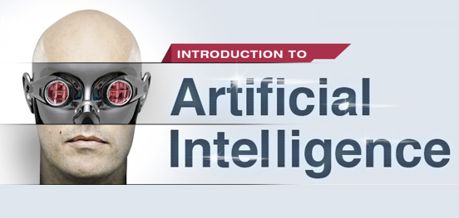

Slide 2
Purpose of this Class
To teach you the very basics of artificial intelligence.

Slide 3
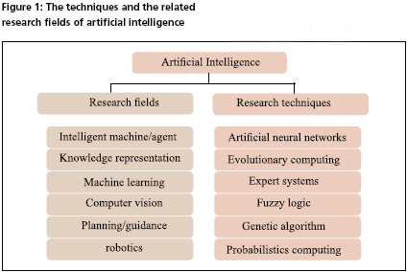
What is the AI?

Slide 4
Intelligent Agents
A computer program interact with an environment.
The agent can perceive the state of environment through its sensors.
It can affect its state through its actuators.
AI manage the function that maps sensors to actuators.
AI is about how an intelligent agent makes decisions.

Slide 5
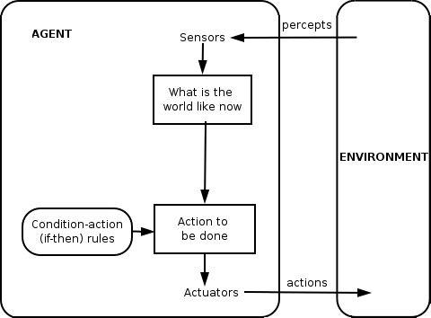
Intelligent Agents

Slide 6
Applications of AI
Finance (Making trading decisions)
Robotics
Games
Medicine (diagnostic medical agents)
The Web
And many more …

Slide 7
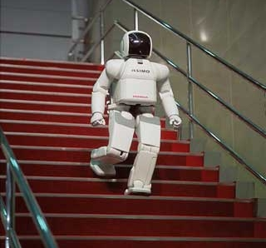
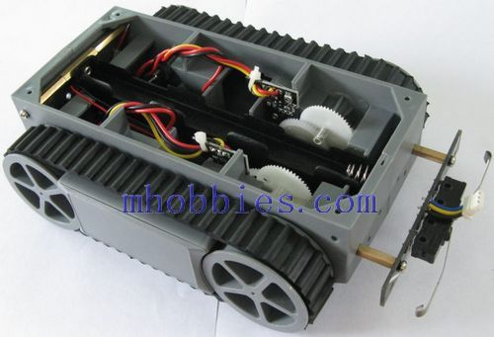
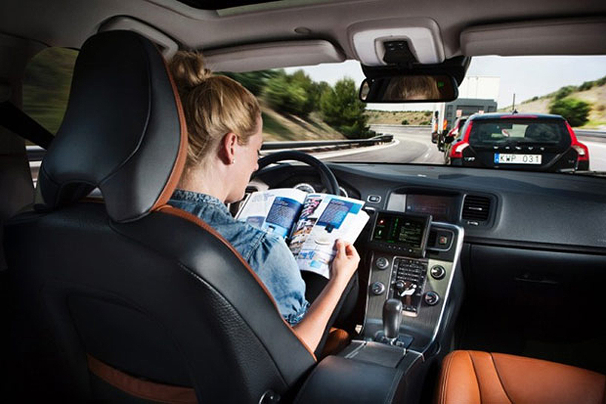
AI in Robotics
Notes:
What sensors? What actuators? System details ?
RodneyBrooks_2003-480p-ar

Slide 8
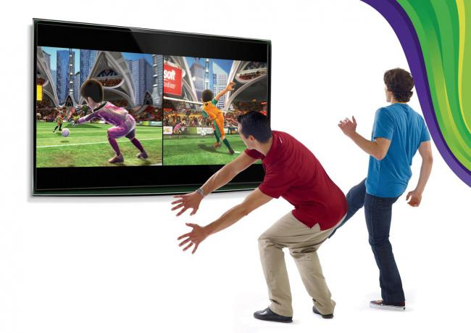
AI and Computer Vision
Notes:
object tracking

Slide 9
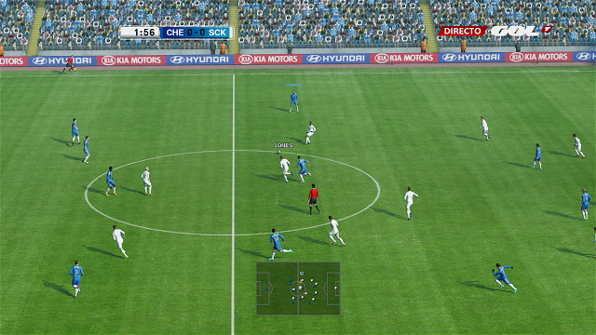
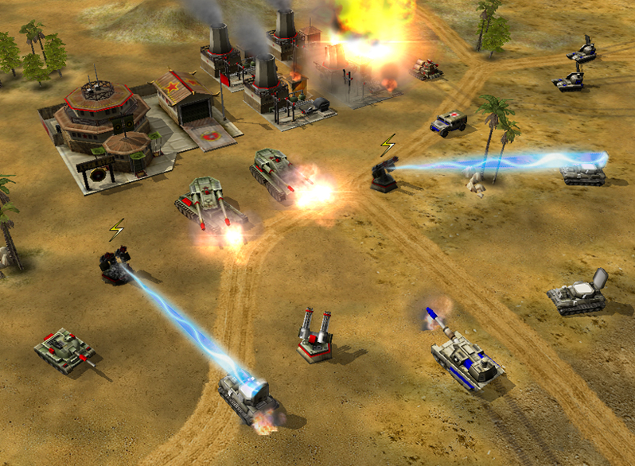
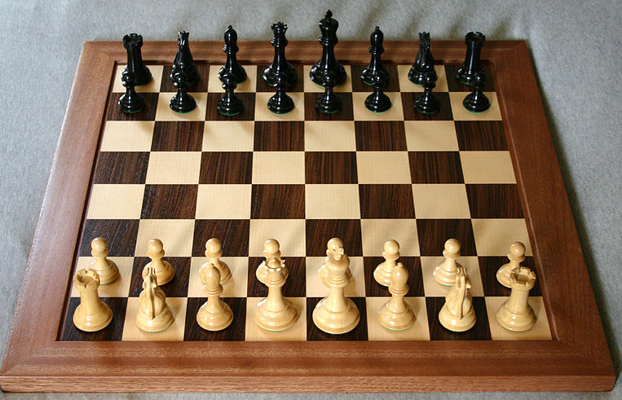
AI in Games

Slide 10
AI in Games
Unbeatable tic tac teo:
http://perfecttictactoe.herokuapp.com/
Sudoku :
https://www.youtube.com/watch?v=VFDR-Lq9cYo
simple soccer
Notes:
| ?- set_prolog_flag(toplevel_print_options,
[quoted(true),numbervars(true),portrayed(true),max_depth(30)]).
yes
| ?- consult('C:/Users/user/Desktop/sud.pl').
% consulting c:/users/user/desktop/sud.pl...
% consulted c:/users/user/desktop/sud.pl in module user, 18 msec -56 bytes
yes
| ?- sudoku([_, _, 2, 3, _, _, _, _, _, _, _, _, 3, 4, _, _],Solution).
Solution = [4,1,2,3,2,3,4,1,1,2,3,4,3,4,1,2] ?
yes

Slide 11
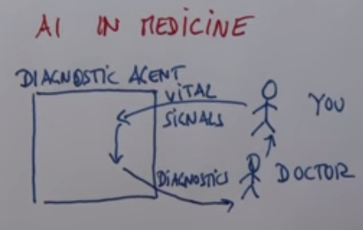
AI in Medicine

Slide 12
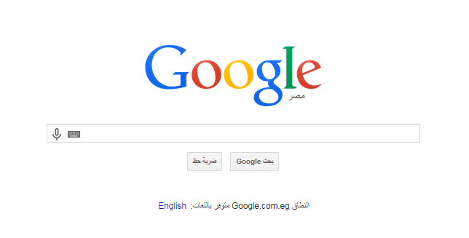
AI in Web

Slide 13
AI and Uncertainty
Reasons of Uncertainty:
Sensor limit
Stochastic Environment
Notes:
AI is the technique of uncertainty management in computer software
AI is the discipline that you apply when you want to know what to do

